Slide 1
Music Mood Classification
By
Team-16 (Nikhita,Praneeth)

Slide 2
Introduction
The Idea of this project is to classify different music tracks into their respective mood based on their features.
13 features
1476 records
Data Source Kaggle

Slide 3
What did we do?
Data cleaning
Created moods for classification
Model building
Evaluation

Slide 4
Moods
Dinner
Workout
Party
Sleep

Slide 5
Data Preprocessing
Remove unnecessary columns
Missing values imputation
Combine Datasets
Scalar Transformation
Train and Test split (70-30)

Slide 6
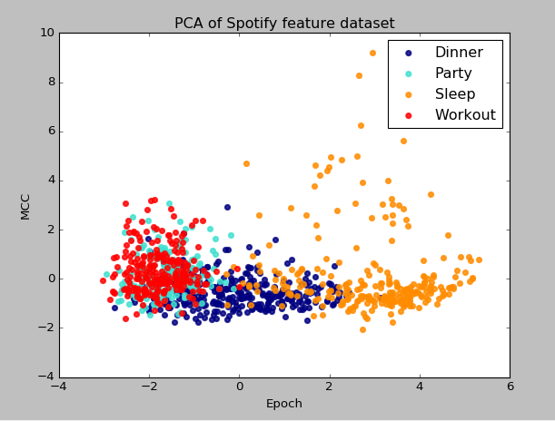
Data Distribution

Slide 7
Support Vector Machine
SVM Model
parameter_candidates = [{'C': [1, 5, 10, 15, 20, 50, 100], 'gamma': [0.5, 0.05, 0.005, 0.01, 0.001, 0.0001, 0.00001], 'kernel': ['rbf','poly','sigmoid']}] -------------------------------------------------------------------------------------------------------------------------------------- svm_grid_model = GridSearchCV(estimator=svm.SVC(), param_grid= parameter_candidates, refit= True) Best C: 100 || Best gamma: 0.001 || Best Kernel : rbf
Accuracy
0.731376975169

Slide 8
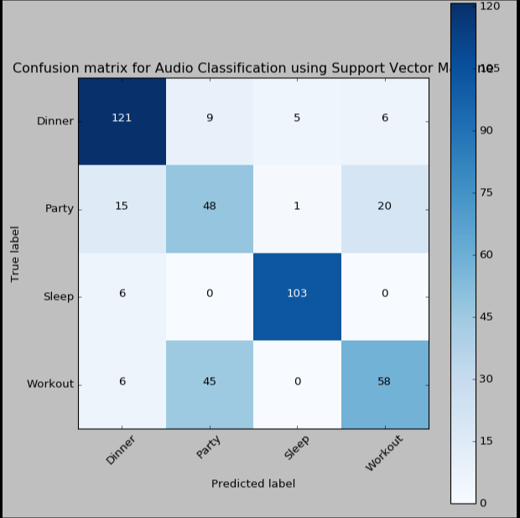
Support Vector Machine

Slide 9
Neural Networks
MLP Classifier
gs = GridSearchCV(nn, param_grid={ 'n_iter': [100,500,1000], 'learning_rate': [0.01, 0.001], 'hidden0__units': [10, 20, 5], 'hidden0__type': ["Rectifier", "Sigmoid", "Tanh"]},refit=True) ---------------------------------------------------------------------------------------------- nn = Classifier( layers=[ Layer('Sigmoid',dropout=0.20), Layer("Softmax")], valid_size=0.2, callback={'on_epoch_finish': store_stats})

Slide 10
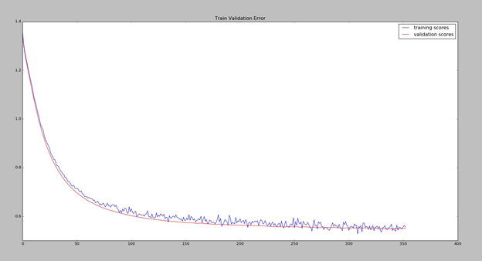
Multi-Layer Perceptron
Best Estimarors
Hidden Layer : Sigmoid | # of Neurons in Hidden Layer : 5 | Learning Rate : 0.001

Slide 11
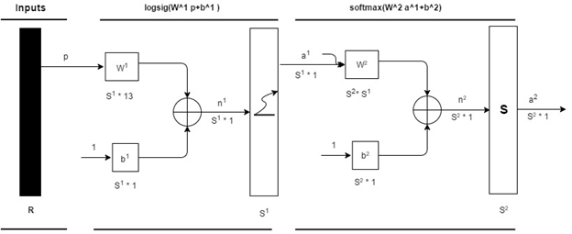
Multi-Layer Perceptron
# of Neurons
S1 = 5, S2 = 4

Slide 12
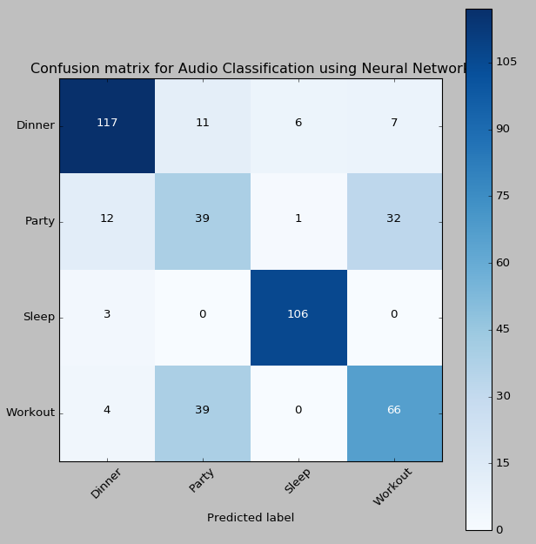
Multi-Layer Perceptron

Slide 13
Models Summary
 | Neural Network | SVM
# of misclassifications | 115 | 113
Precision | 0.74 | 0.75
Recall | 0.74 | 0.74
F1 score | 0.74 | 0.74
Accuracy | 74.04% | 74.5%

Slide 14
Conclusion and Enhancements
Conclusion
Neural Networks and SVM have similar accuracy and classification
Dinner and Sleep are classified correctly but, party and workout fail to be classified
SVM is faster than Neural Networks
Enhancements
Exploring the features and eliminating similar features for party and workout moods.
Using other classification Algorithms.

Slide 15
THANK YOU

